Slide 1
How to explore all feasible near optimal solutions for an energy-economic optimization problem?

Slide 2

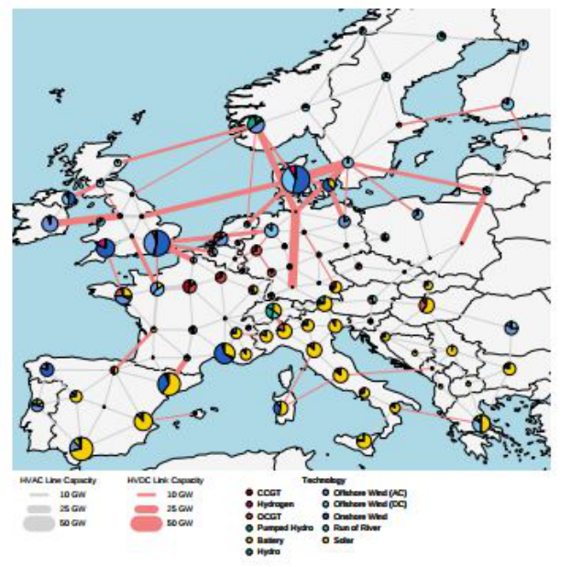




Objective function
Constraints
MGA Objective function

Slide 3
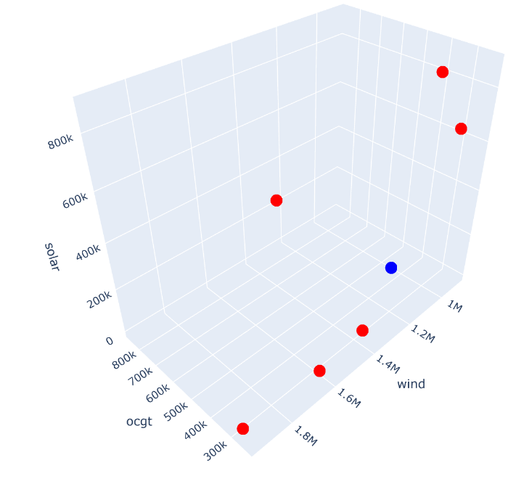
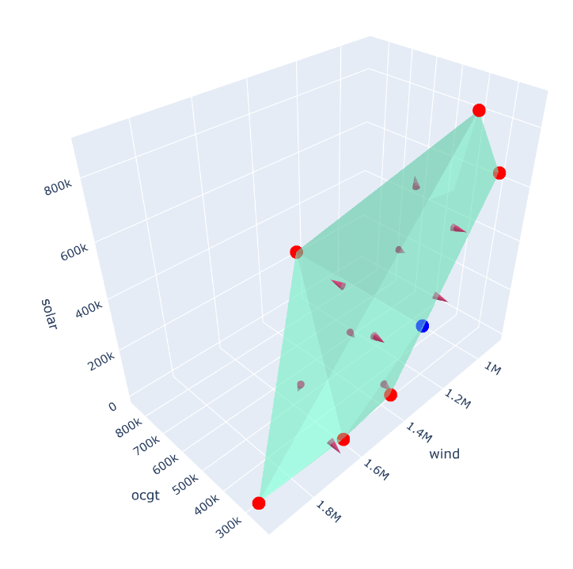
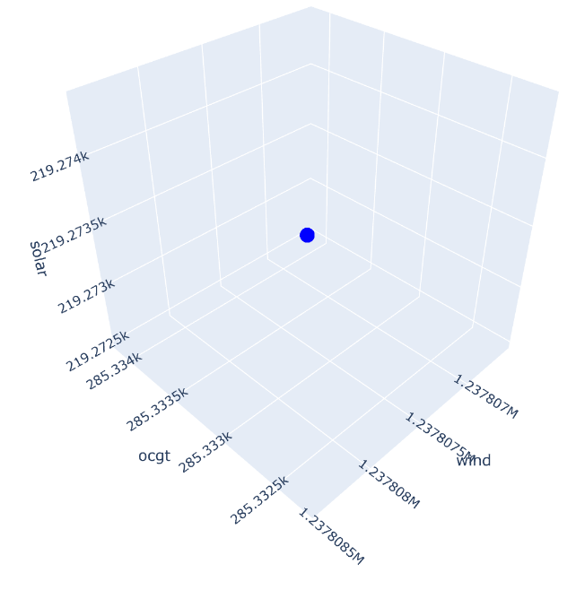
Step 1
Find the optimal solution
Step 2
Maximize/Minimize all variables
Step 3
Create hull of the found solutions, and search in all face normal directions

Slide 4
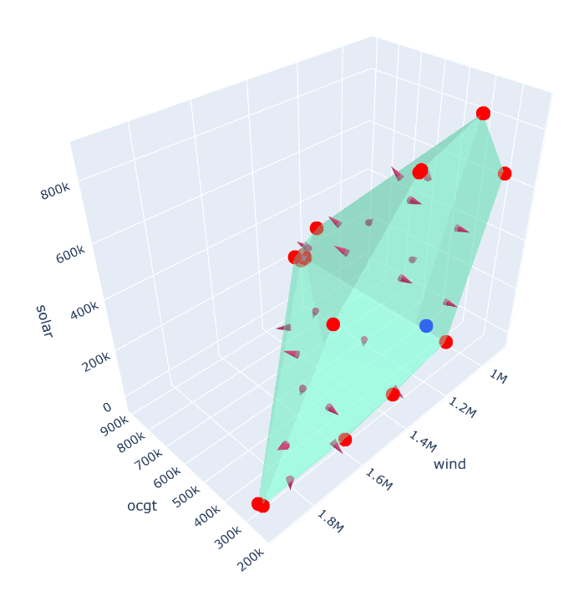
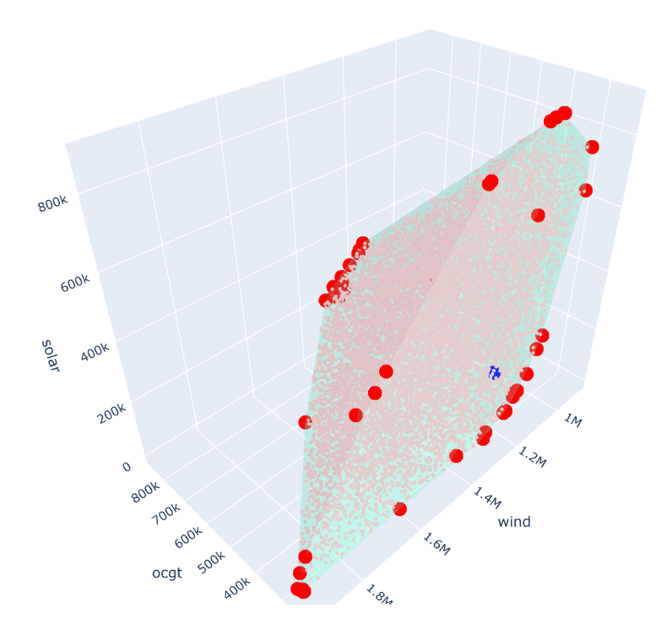
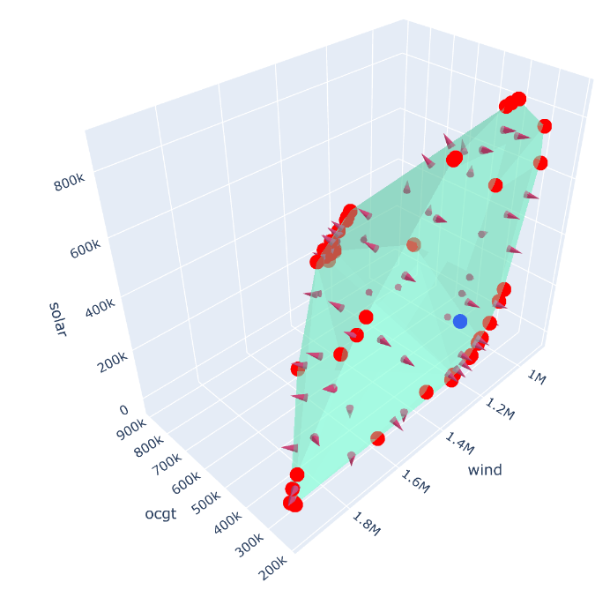
Step 4
Repeat step 3 until size of hull converges
Step 5
Fill hull with randomly distributed points

Slide 5
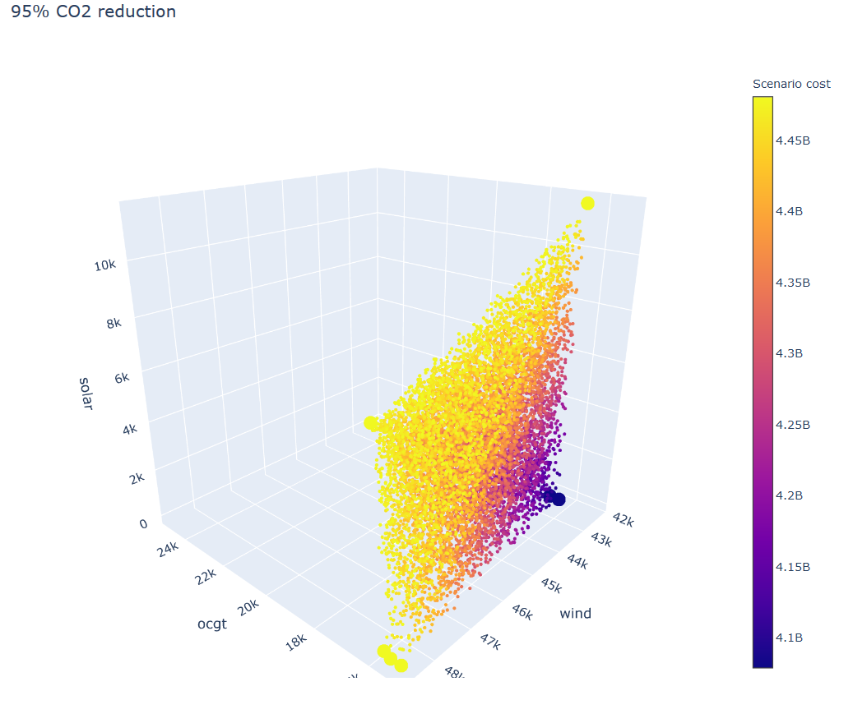
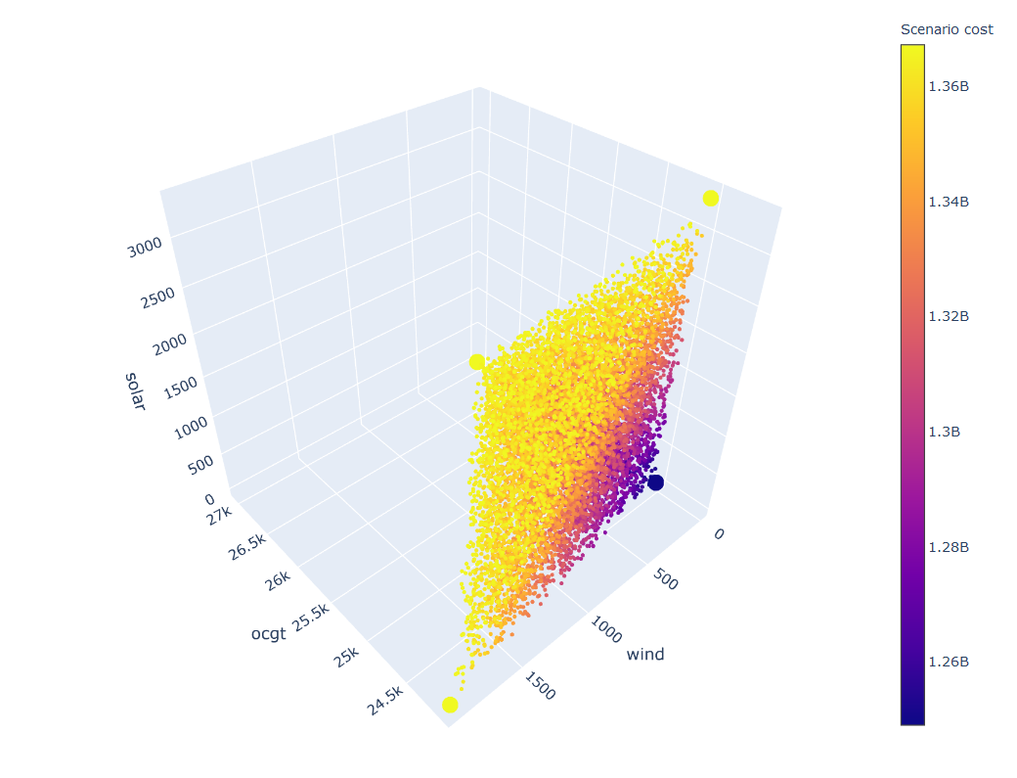
Simple test case
Business as usual
80% CO2 reduction

Slide 6
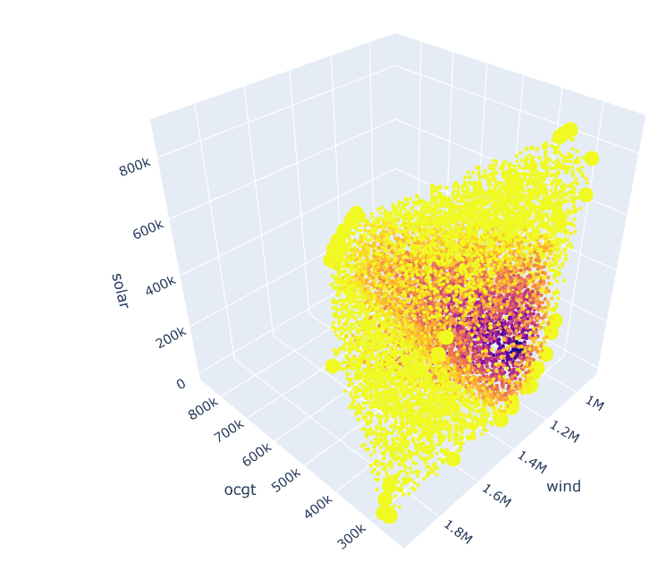
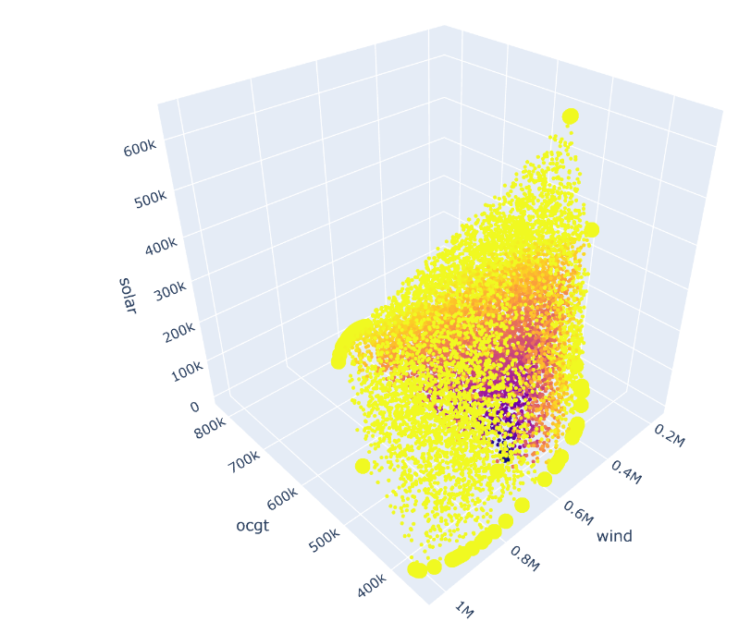
Europe model
Business as usual
80% CO2 reduction

Slide 7
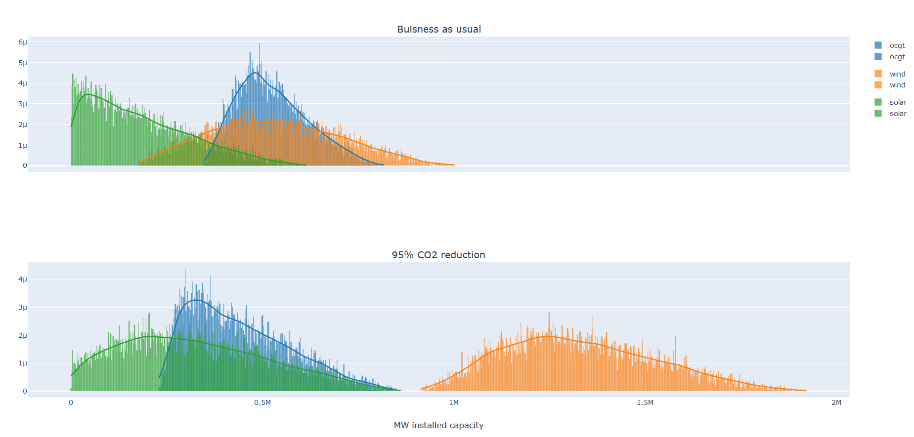
Europe model
80% CO2 reduction

Slide 8
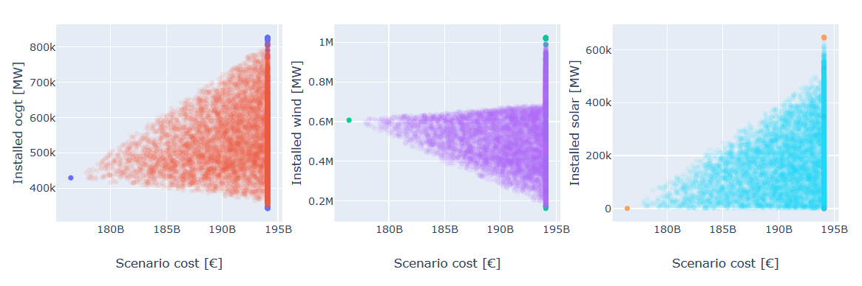
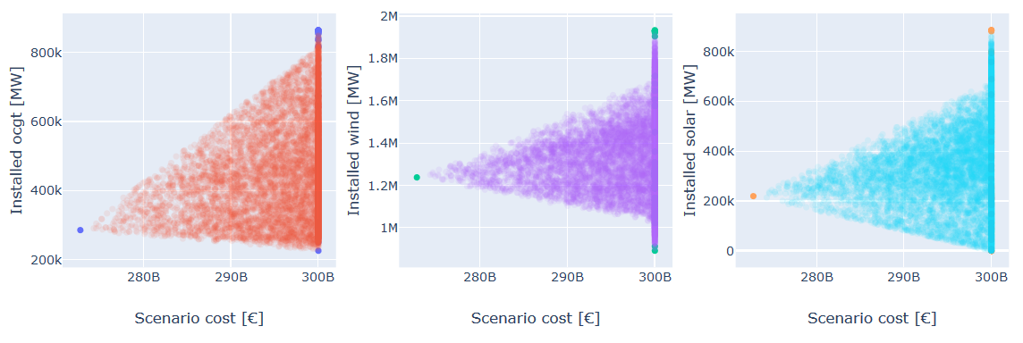
Business as usual
80% CO2 reduction

Slide 9
